Slide 1


The Color Quiz
What color are you?

Slide 2
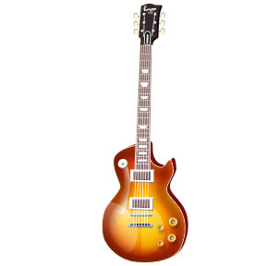
RED
(ISFP, ESFP, ISTP, ESTP)
“Artist”
Good communicator
Adaptable
Look for exciting experiences
Set goals
Composer, crafter, performer
Possible Careers:
Musician, Actor, Dancer, etc.

Slide 3
Blue
(INTP, ENTP, INTJ, ENTJ)
“Inventor”
Rational
Set goals
Strong-willed
Like to learn
Abstract
Possible Careers:
Architect, Inventor, Scientist, etc.

Slide 4

Yellow
(ISTJ, ESTJ, ISFJ, ESFJ)
“Guardian”
Cooperative
Reliable
Do good deeds
Like security
Good communicator
Possible Careers:
Supervisor, Volunteer, Firefighter, etc.

Slide 5



Green
(INFP, ENFP, INFJ, ENFJ)
“Healer”
Good communicator
Cooperative
Empathetic / Care for other people
Authentic or honest
Work well with others
Possible Careers:
Counselor, Teacher, Nurse, etc.

Slide 6


Now What?
Reflection…
What makes you special?
Group work
Discuss your color’s strengths as a group
Decorate your poster to show these strengths

